Slide 1
Programming fundamentals
Week 01 – Introduction to Fundamentals of programming
Course Instructor : Engr.Asma Khan

Slide 2
Why learn programming languages??
What is programming?
Why programming is important
Critical reading
Analytical thinking
Creative synthesis
3. What skills are needed?
Paying attention to detail
Think about the reusability.
Think about user interface
Understand the fact the computers are stupid
Computers are incredibly stupid. They do exactly what you tell them to do: no more, no less-- unlike human beings. Computers can't think by themselves
4.Develop a basic recipe for writing programs

Slide 3
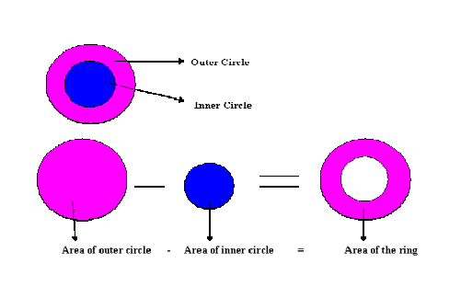
Program to calculate the area of a circle:

Slide 4
Recipe of making a program
Hence to design a program properly, we must:
o Analyze a problem statement, typically expressed as a word problem.
o Express its essence, abstractly and with examples.
o Formulate statements and comments in a precise language.
o Evaluate and revise the activities in light of checks and tests and o Pay attention to detail.

Slide 5
Translators
There are two kinds of translators which are known as Interpreter and Compilers. These translators translate our program which is written in C-Language into Machine language. Interpreters translates the program line by line meaning it reads one line of program and translates it, then it reads second line, translate it and so on. The benefit of it is that we get the errors as we go along and it is very easy to correct the errors. The drawback of the interpreter is that the program executes slowly .
The Compiler read the whole program and translates it into machine language completely. The difference between interpreter and compiler is that compiler will stop translating if it finds an error and there will be no executable code generated whereas Interpreter will execute all the lines before error and will stop at the line which contains the error. So Compiler needs syntactically correct program to produce an executable code.

Slide 6
Debugger
Another important tool is Debugger. Every programmer should be familiar with it. Debugger is used to debug the program i.e. to correct the logical errors. Using debugger we can control our program while it is running. We can stop the execution of our program at some point and can check the values in different variables, can change these values etc. In this way we can trace the logical errors in our program and can see whether our program is producing the correct results.

Slide 7
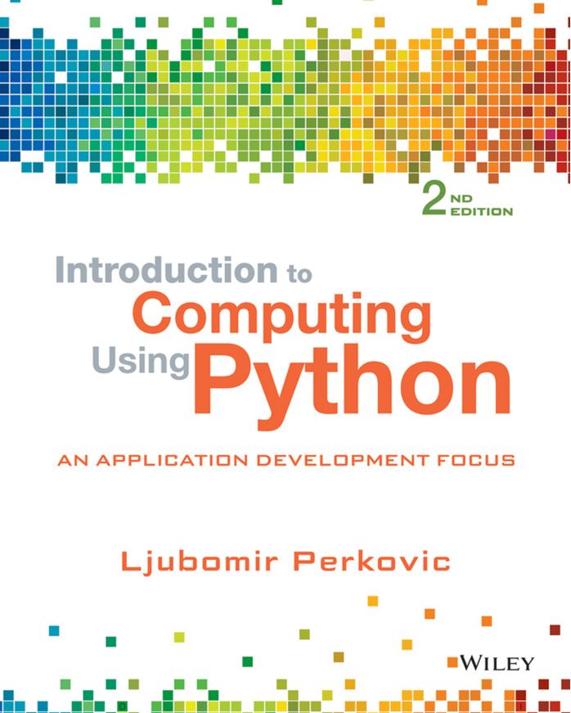
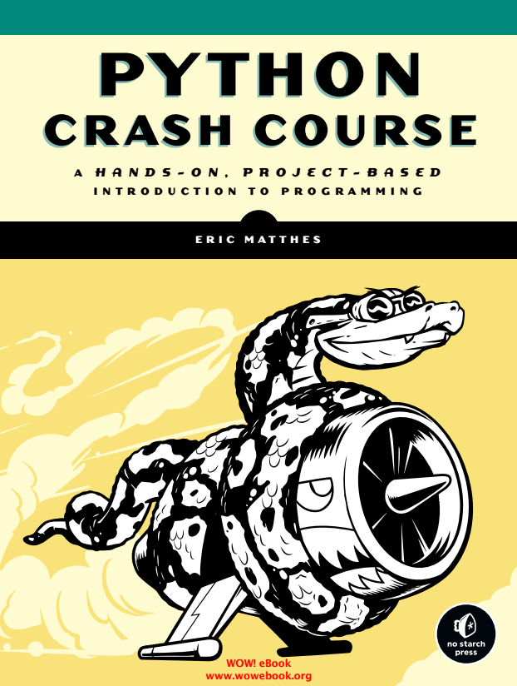
Course books & Materials

Slide 8
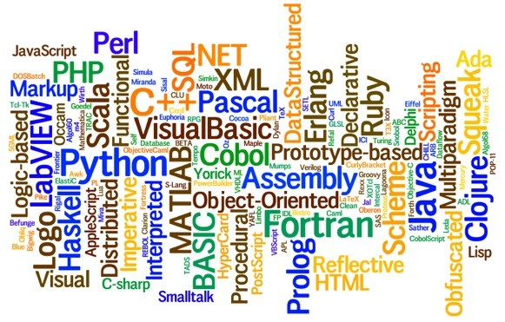
Programming languages

Slide 9
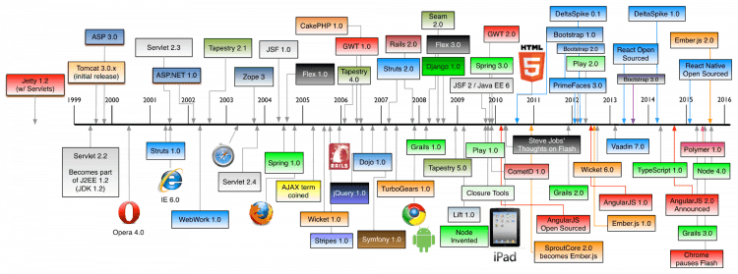
Programming languages

Slide 10
Why Python?
Python works on different platforms (Windows, Mac, Linux, Raspberry Pi, etc).
Python has a simple syntax similar to the English language.
Python has syntax that allows developers to write programs with fewer lines than some other programming languages.
Python runs on an interpreter system, meaning that code can be executed as soon as it is written. This means that prototyping can be very quick.
Python can be treated in a procedural way, an object-orientated way or a functional way.
Python relies on indentation, using whitespace, to define scope; such as the scope of loops, functions and classes. Other programming languages often use curly-brackets for this purpose.

Slide 11
History of python
Python was conceptualized by Guido Van Rossum in late 1980s.
Rossum published the fisrt version of python code (0.9.0) in Feb 1991 in Netherland.
Python is derive from ABC programming language, which is a general purpose programming language.
He has selected the name since he was a big fan of Monty Python’s Flying Circus.

Slide 12
What can Python do?
Python can be used on a server to create web applications.
Python can be used alongside software to create workflows.
Python can connect to database systems. It can also read and modify files.
Python can be used to handle big data and perform complex mathematics.
Python can be used for rapid prototyping, or for production-ready software development.

Slide 13
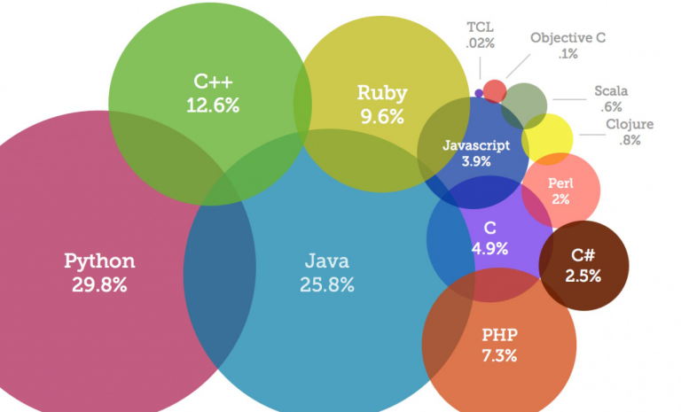
programming languages & Trends (2018)

Slide 14
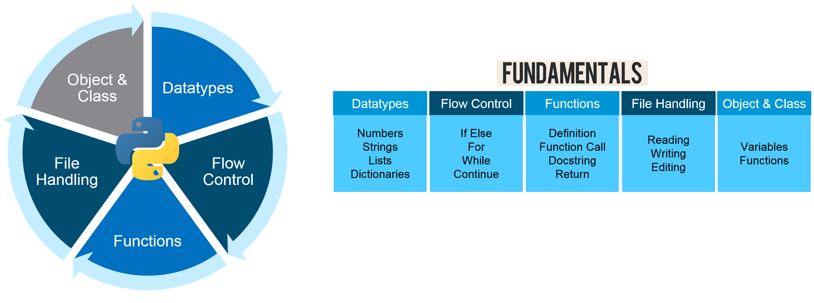
What comes under fundamentals?

Slide 15
Course outline
Language Fundamentals
Introduction
Definitions
Decision Controls
If else
conditions
Loops
For loop
While loop
Functions
Arrays
Body of functions
Writing of functions
1D and 2D arrays
Concepts
Pointers
Concepts of data accessing
Accessing data using pointers
Lists
Concepts
1D and 2D List
Dictionaries
Concept
Operations, Methods
File I/O
Types of filing
Concept

Slide 16
Python Advantages & Disadvantage
Simple and Easy
Extensible
Embeddable
Improved Productivity
IOT Opportunities
Extensive Libraries
Readable
Object Oriented
Free and Open Source
Portable
Speed Limitation
Design Restrictions
Simple
Underdeveloped Database Access Layers
Weak in Mobile Computing & Browsers

Slide 17
Python comparison to other languages
“Hello World Program in Python
Print (“Hello World !”)
“Hello World Program in C++
#include<iostream>
using namespace std;
int main()
{
print (“Hello World !”);
return 0;
}
“Hello World Program in Java
public class HelloWorld{
Public static void main (String[] args)
{
System.out.println(“Hello World !”);
}
}
“Hello World Program in C
#include<stdio.h>
int main()
{
print (“Hello World !”);
return 0;
}

Slide 18
Introduction to python programming
Some commonly acknowledged reasons
Short development time
Learning curve is not so steep as other languages
Anaconda is a big self contained Python distribution
Large library base
Runs on many platforms

Slide 19
Reserved words in python
and | assert | break | class | continue
def | del | elif | else | except
exec | finally | for | from | global
if | import | in | is | lambda
not | or | pass | print | raise
return | try | while

Slide 20
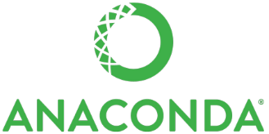
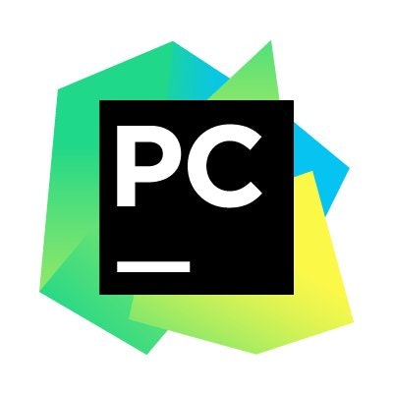
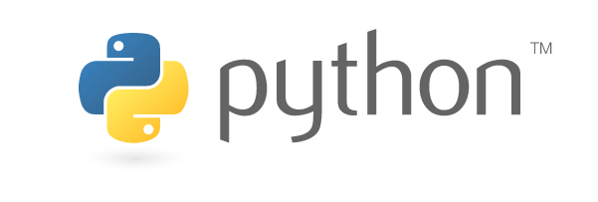
Python installation
Anaconda Continuum framework
Python interpreter
Pycharm IDE
https://www.anaconda.com/download/
https://www.python.org/downloads/

Slide 21
End of Lecture – Week 01

